Slide 1
Project using Python with MySQL

Slide 2
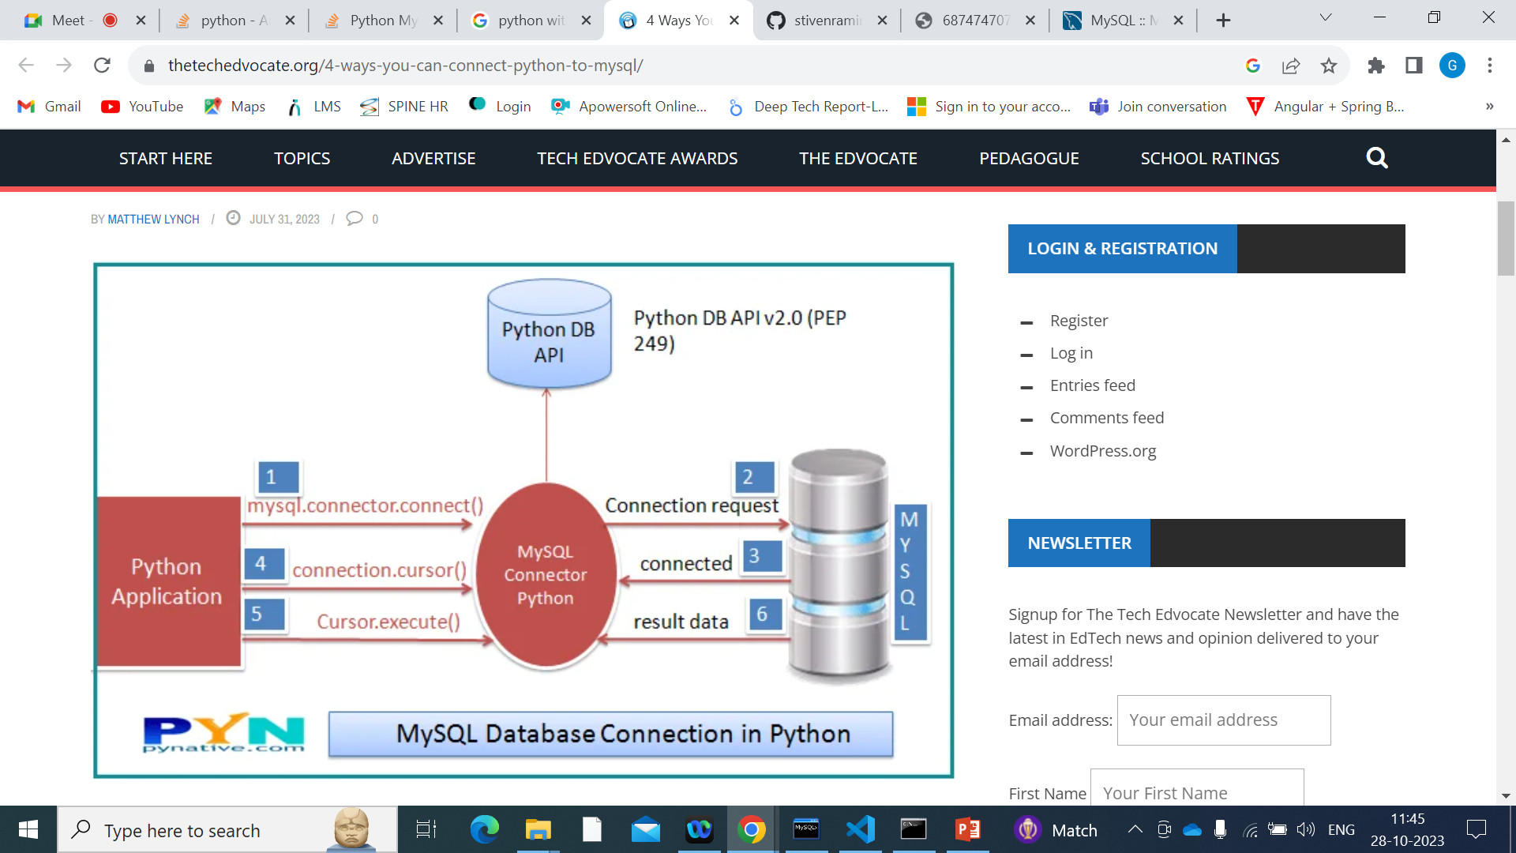

Slide 3
Steps to keep in Mind
Connecting to MySQL Using Connector/Python
import mysql.connector
self.con=mysql.connector.connect(host='localhost’, port='3306',user='root’, password='root', database='pythontest')
2. Creating Query
query = 'create table if not exists book(bookId int primary key, bookName varchar(100),bookPrice int)'
3. Creating cursor
mycur=self.con.cursor()
4. Executing the Query using cursor
mycur.execute(query)
5. Commiting the transaction
self.con.commit()

Slide 4
CRUD operations implemented
Insert Book data
Delete Book data based on ID
Update Book Name and price based on ID
Fetch all the data from the Book Table

Slide 5
Things to be implemented
New table Author with foreign key reference in Book table and all CRUD operations
Add Order Table
Add quantity column in the book table that will reduce with every order placed
Exception handling for the wrong Book ID inserted

